Slide 1
SEBA ( সেবা) A NGO MANAGEMENT System Presented by: Quest
Ashfaq Ali Shafin ID: 14.01.04.111
Irtiza Abir ID: 14.01.04.122
AbID Hasan Prottoy ID: 14.01.04.125

Slide 2
Topic
Entity Relation Diagram
Unified Modeling Language

Slide 3
Entity Relation Diagram
ERD

Slide 4
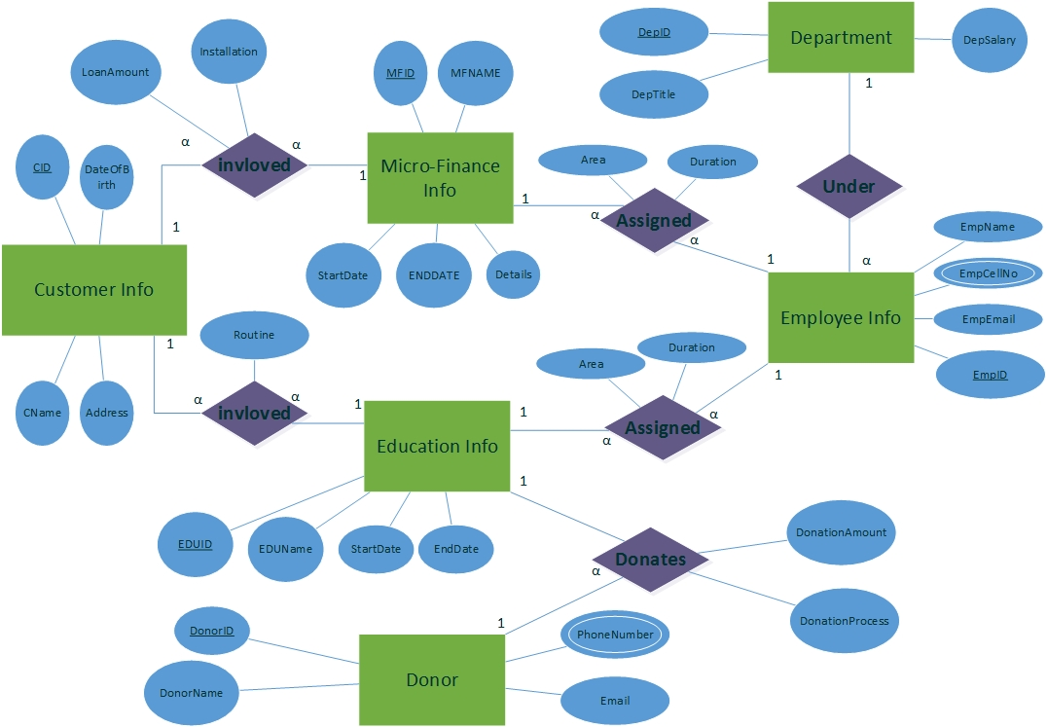
ERD of NGO Management System

Slide 5
MicroFinace_Info(Table)
Attribute | Type
MFID | Int (Primary Key)
MFName | Varchar(100)
StartDate | Date
EndDate | Date
Details | Varchar(1000)

Slide 6
Education_Info(Table)
Attribute | Type
EDUID | INT (Primary Key)
EDUNAME | Varchar(100)
StartDate | Date
EndDate | Date

Slide 7
Customer_Info
Attribute | Type
CID | INT (Primary Key)
CName | VarChar(100)
DateOfBirth | Date
Address | VarChar(1000)

Slide 8
Donor_Info
Attribute | Data Type
DonorID | INT (Primary Key)
DonorName | Varchar(100)
PhoneNumber (Multivalued) | Varchar(100)
Email | Varchar(100)

Slide 9
Department
Attribute | Data Type
DeptID | INT (Primary Key)
DeptTitle | Varchar(100)
DeptSalary | Float

Slide 10
Employee_Info
Attribute | Data Type
EmpID | INT (Primary Key)
EmpName | Varchar(100)
EmpCellNo (Composite Value) | Varchar(100)
EmpMail | Varchar(100)

Slide 11
Donation
Attribute | Data Type
DonorID | INT (Foreign Key)
EDUID | INT (Foreign Key)
DonationAmount | Float
Donation Process | Varchar(100)
DonorID, EDUID | (Primary Key)

Slide 12
CustomerUnderEducation
Attributes | Data Type
CID | INT (Foreign Key)
EDUID | INT (Foreign Key)
Routine | Varchar(70)
CID,EDUID | (Primary Key)

Slide 13
CustomerUnderMicrofinace
Attribute | Data Type
CID | INT (Foreign Key)
MFID | INT (Foreign Key)
LoanAmount | Float
Installation | Float
CID,MFID | (Primary Key)

Slide 14
EducationAssignedEmployee
Attributes | Data Type
EDUID | INT (Foreign Key)
EmpID | INT (Foreign Key)
Area | Varchar(100)
Duration | Varchar (10)
EDUID, EmpID | (Primary Key)

Slide 15
MicroFinanceAssignedEmployee
Attributes | Data Type
CFID | INT (Foreign Key)
EmpID | INT (Foreign Key)
Area | Varchar(100)
Duration | Varchar (10)
CFID, EmpID | (Primary Key)

Slide 16
Unified Modeling Language
UML

Slide 17
Purpose
Analysis and design of the static view of an application.
Describe responsibilities of a system.
Base for component and deployment diagrams.
Forward and reverse engineering.

Slide 18
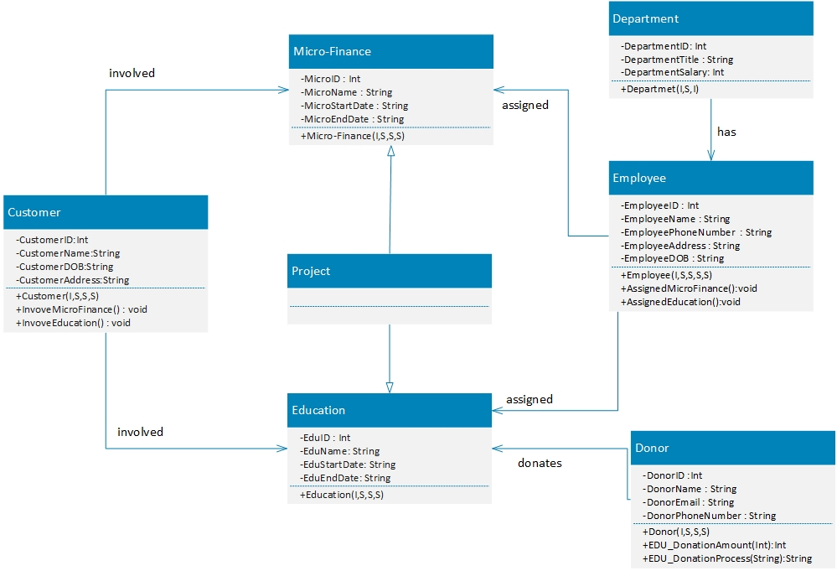
UML: NGO Management System

Slide 19

Question ??

